Slide 1



AUTONOMOUS SHIPPING Sprint 9
Jasper Vlaar, Jelte Molenaar, Job Vink, Michiel van Soest en Martin de Rijke

Slide 2
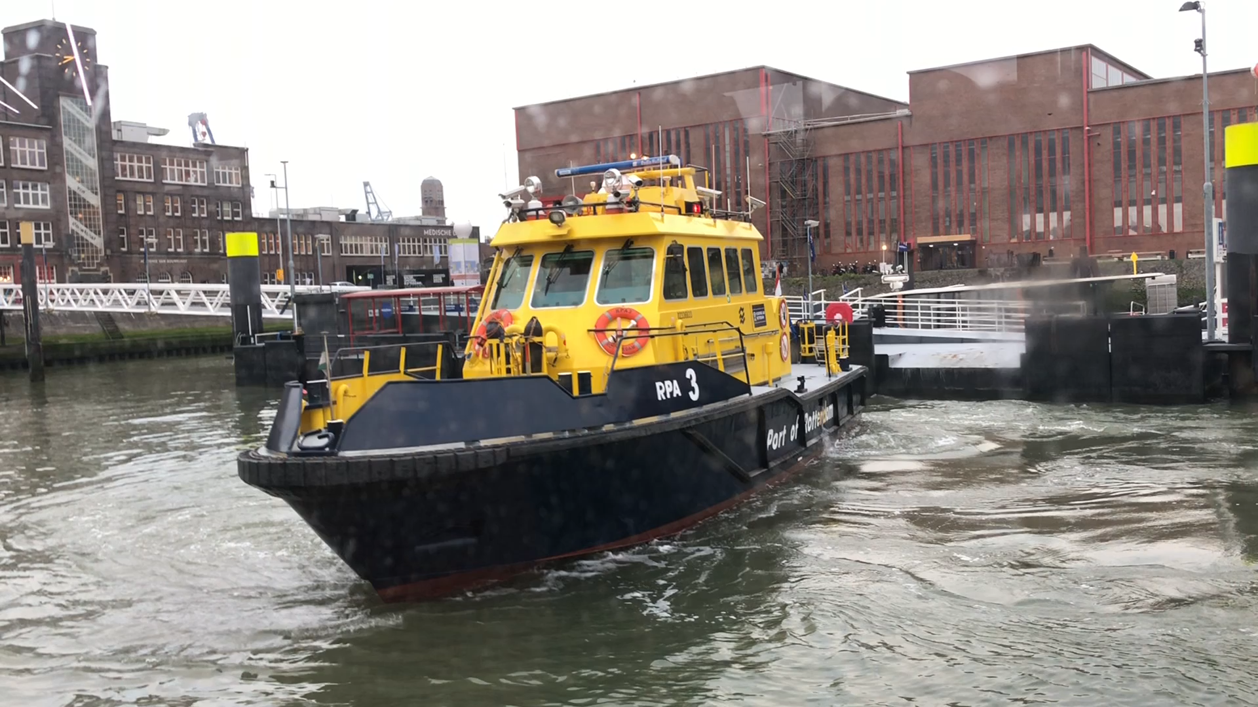
Autonomous shipping

Slide 3
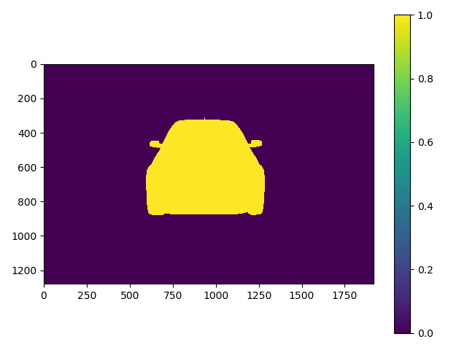
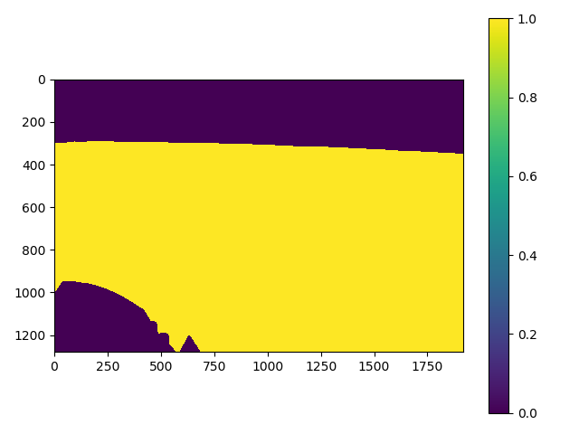
Pytorch_Unet

Slide 4
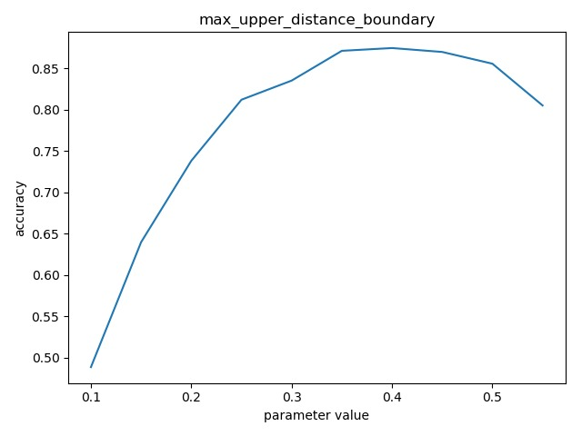
Hyperparametering

Slide 5
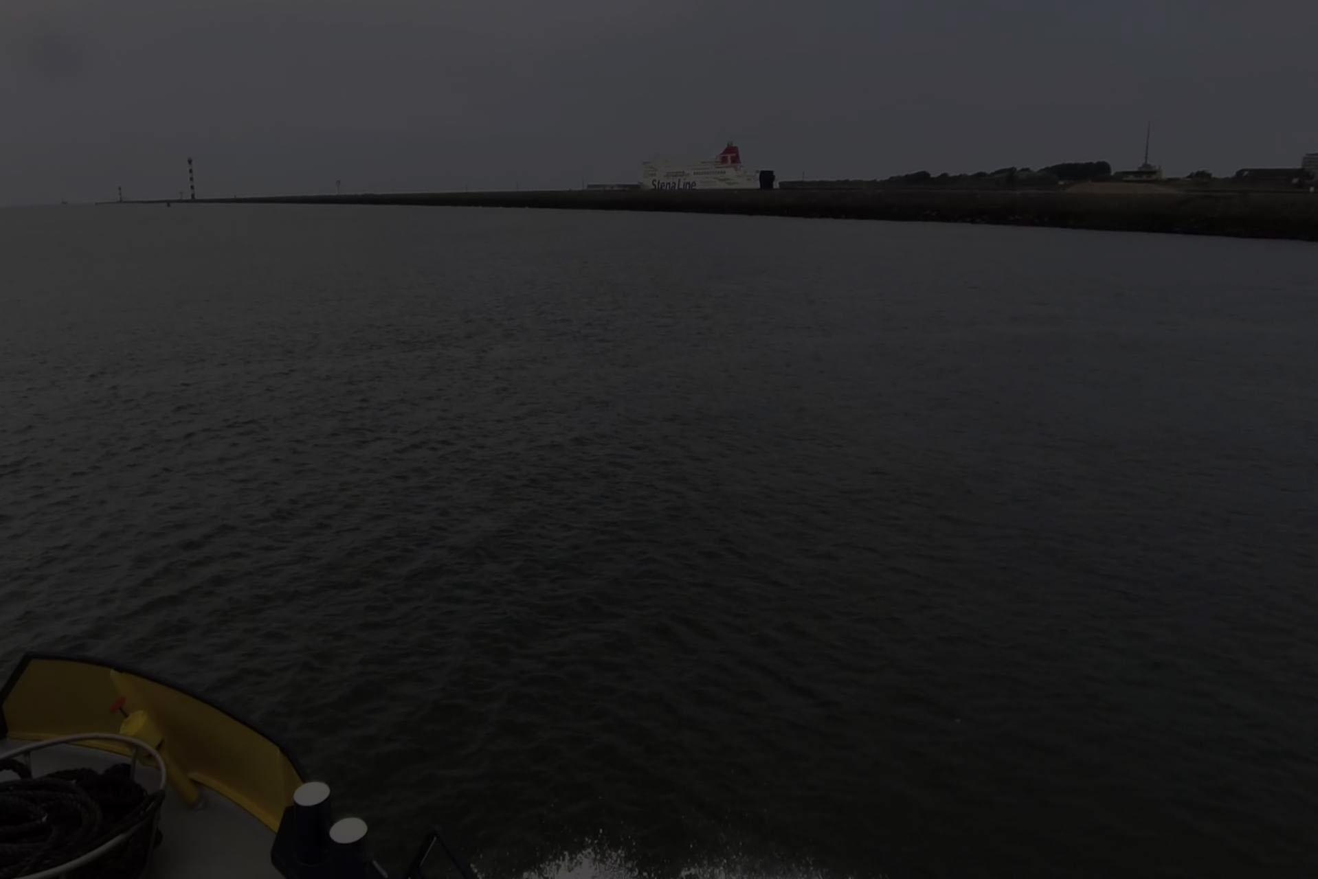

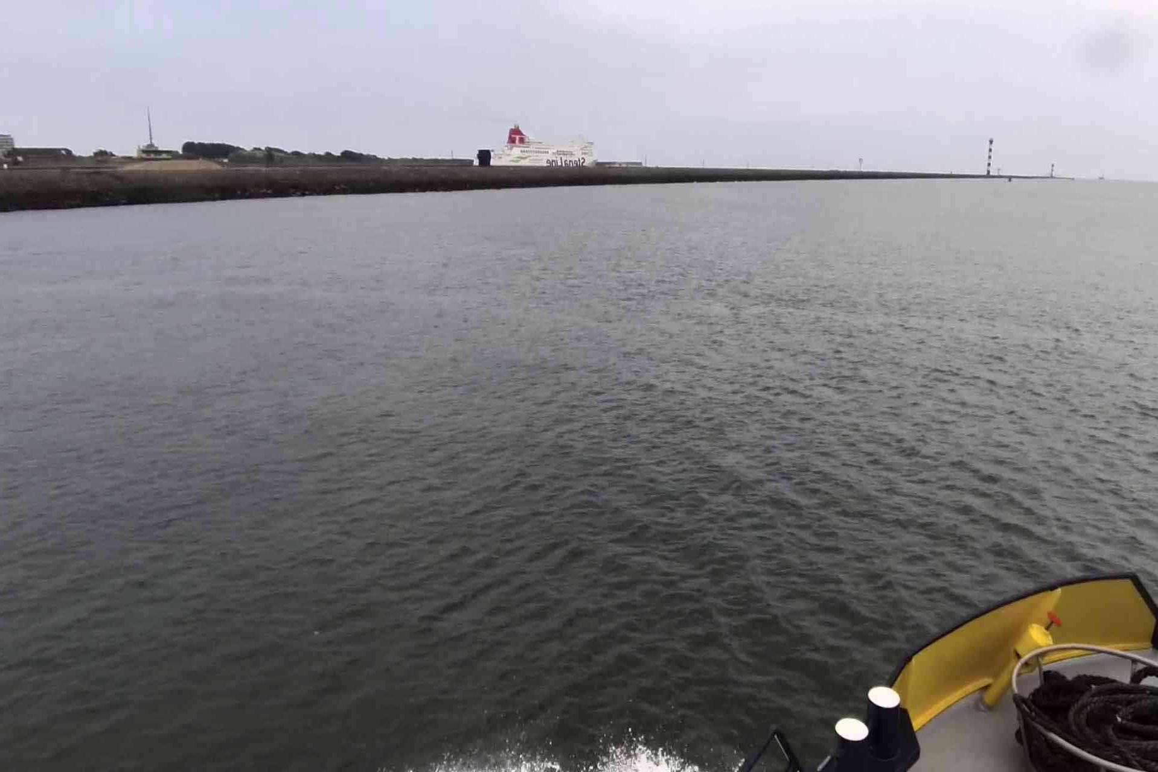

Image preprocessing
Brightness
Contrast
Sharpness
Colour
Mirrored

Slide 6

Strategic sourcing award

Slide 7

Next week
Portfolio

